Slide 1
E-commerce Sprint 1 Project.
Presented by:-Ketki Kulkarni.

Slide 2
Database Name:-EcommerceDB1. Database contains Three tables 1) TblCategory. 2) TblLogin. 3) TblProduct. Web Api Name:- EcommerceWebApi.

Slide 3
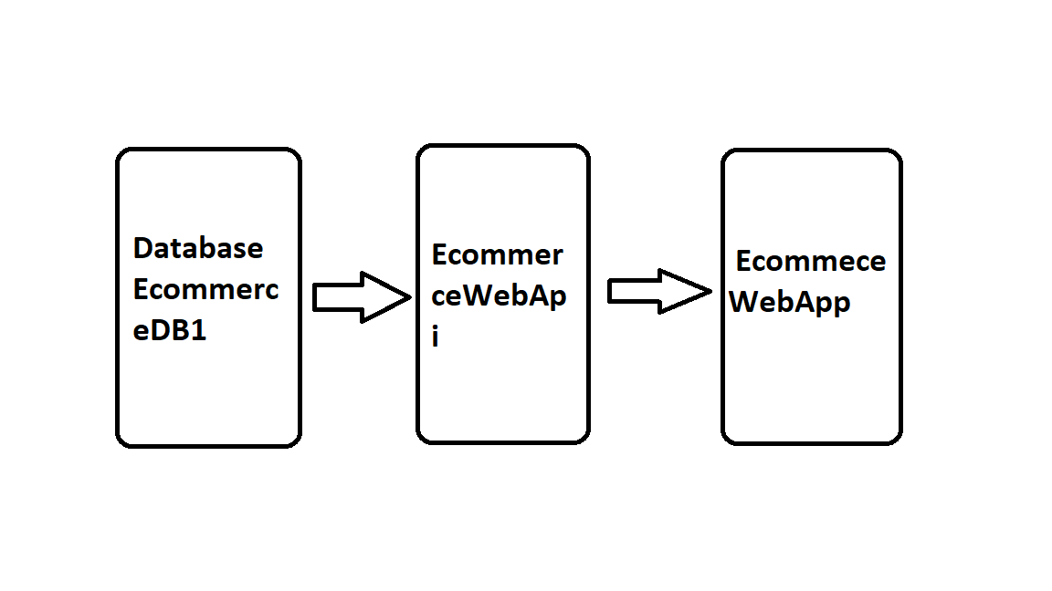
Block Digram.

Slide 4
Flow chart
Angular
To provide interface for client application to have access to data.
Dot Net
SQL
To access data from the database and saveback to database
Front end
Back end
Database
To provide data connectivity between front end and Database.

Slide 5
Features:- User Section:- 1.User can register and login 2.He can purchase product 3.User can see the product. Admin Section:- 1.Admin can login and add categories 2.Admin can add products

